Slide 1


GROUP-9
SECTION-1
Topics : Mal - practice detection during live / inperson / online GD interaction /interviews
FT251009 Akash Singha
FT251030 Hemant Rahalkar
FT251052 Pooja Chandrakar
FT251077 Sarthak Shahpurkar
FT251088 Sonal Baid
FT252055 Nisarg Bakhai

Slide 2
To design an AI-powered system that accurately detects malpractice behaviors during live or online group discussions (GD) and interviews.
To reduce human bias and increase efficiency in identifying violations across diverse environments.
To utilize image processing and machine learning techniques to identify anomalies or suspicious activities.
To ensure fairness and transparency in evaluation processes through automated monitoring.
Project
Objective

Slide 3
Process FlowChart
Data Preprocessing
Model Architecture
Training and Validation
Inference Pipeline
Unzip and organize the dataset for training, validation, and testing.
Use Image Data Generator for data augmentation to enhance model robustness.
Using Convolutional Neural Network (CNN):
Layers include Conv2D, MaxPooling2D, Flatten, Dense, and Dropout.
Activation functions like ReLU and softmax for classification tasks.
Compile the model using categorical cross-entropy and Adam optimizer.
Train the model on labeled data with real-time image augmentation.
Validate accuracy using a separate validation dataset.
Real-time image/video feed preprocessing
Classification of activities to flag anomalies.

Slide 4
Explanation
The model utilizes a CNN architecture designed for image classification tasks.
Input data is processed through convolutional layers to extract features like shapes, patterns, and textures.
Pooling layers reduce dimensionality while preserving critical information for classification.
Fully connected layers handle final classification based on the extracted features.
Dropout layers are included to prevent overfitting by deactivating random neurons during training.
The model is trained to detect malpractice patterns such as unauthorized object usage or unusual hand gestures.
It can analyze video frames in real-time, enabling quick and accurate detection of suspicious activities during live or recorded interactions.

Slide 5
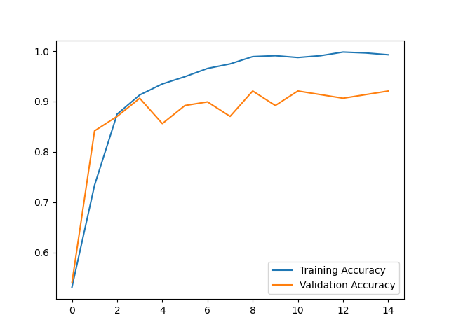
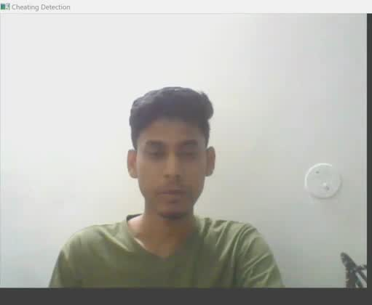
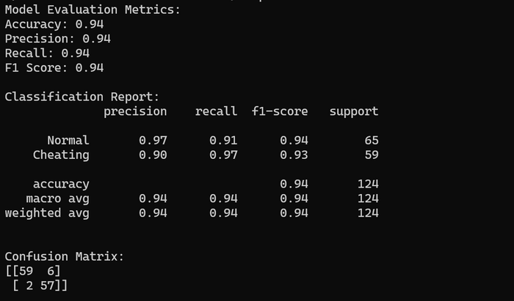
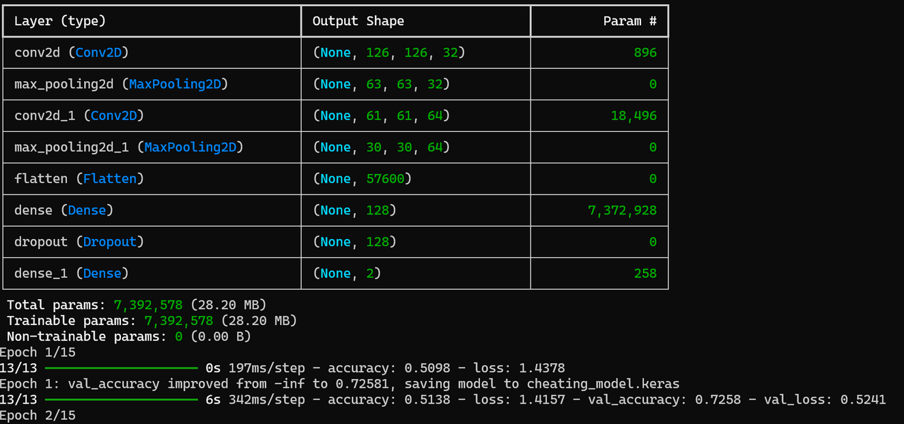
Result

Slide 6
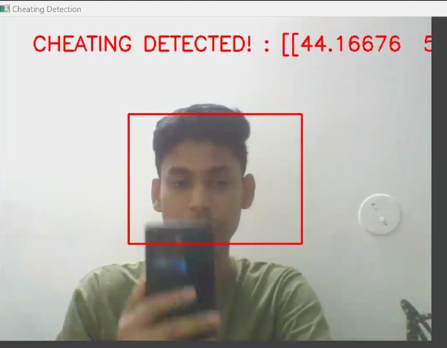
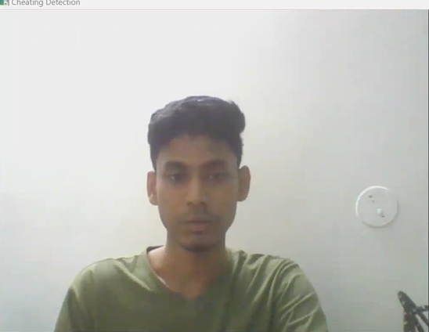
CHEATING
NORMAL

Slide 7
Business Insights
Efficiency & Cost Savings: Automating malpractice detection reduces manual errors and saves time, lowering operational costs.
Scalability: The model is adaptable across industries, including recruitment, academic evaluations, and corporate settings, ensuring broad applicability.
Market Potential: Growing demand for AI-driven evaluation solutions in HR and education sectors presents significant market opportunities.
Accuracy & Decision-Making: Enhances the accuracy of evaluations, leading to better-informed decisions in recruitment and selection processes.
Compliance & Competitive Advantage: Ensures regulatory compliance and positions businesses ahead of competitors seeking reliable evaluation tools.
Future Expansion: Potential to integrate advanced data sources like biometric analytics for further improvement and customization.

Slide 8
To design an AI-powered system that accurately detects malpractice behaviors during live or online group discussions (GD) and interviews.
To reduce human bias and increase efficiency in identifying violations across diverse environments.
To utilize image processing and machine learning techniques to identify anomalies or suspicious activities.
To ensure fairness and transparency in evaluation processes through automated monitoring.
Conclusion

Slide 9
THANK YOU

